Slide 1
Additional Topics

Slide 2
What we have covered
Dynamics CRM Integration points
Microsoft.Xrm API for .net applications
Code Activities
Plugins
WebApi
Javascript API
New App interface

Slide 3
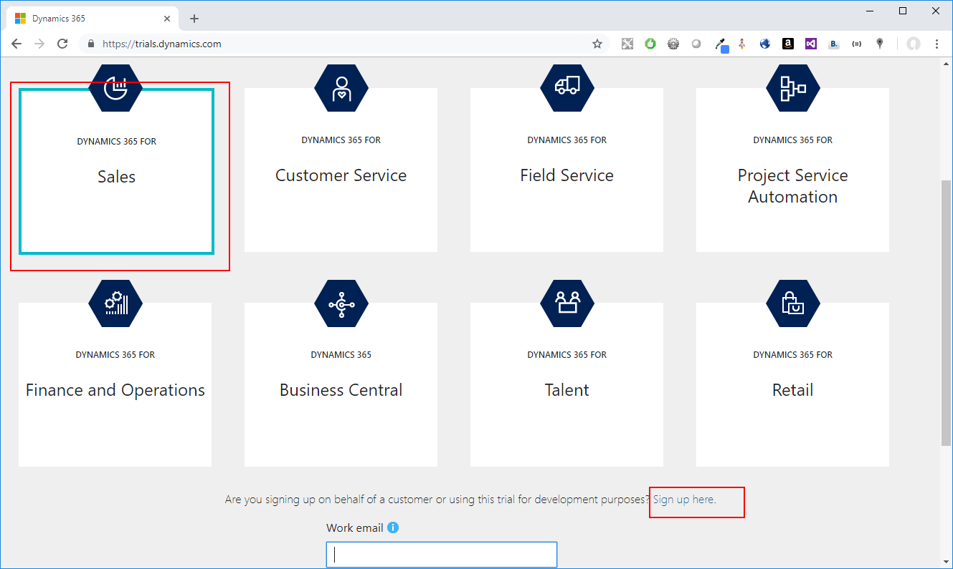
Setting up online Trial
Go to https://trials.dynamics.com
Select “Sales”
click on “Sign up here”

Slide 4
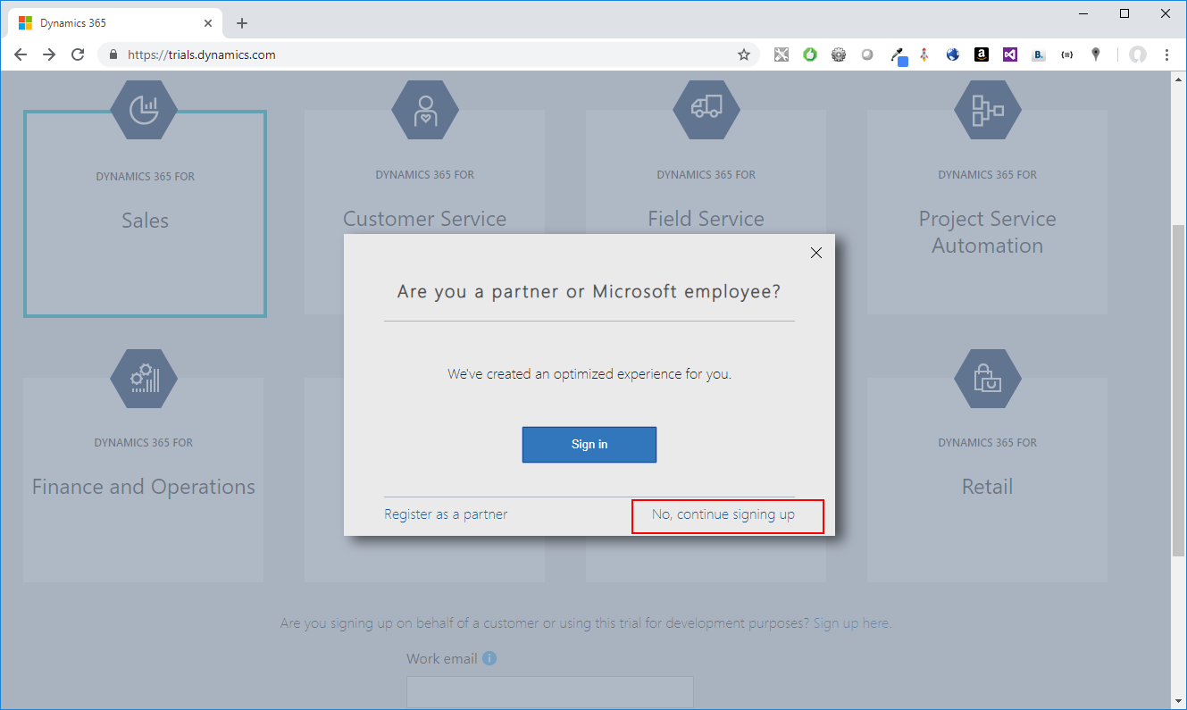
Set up online trial
Choose “No, continue signing up”

Slide 5
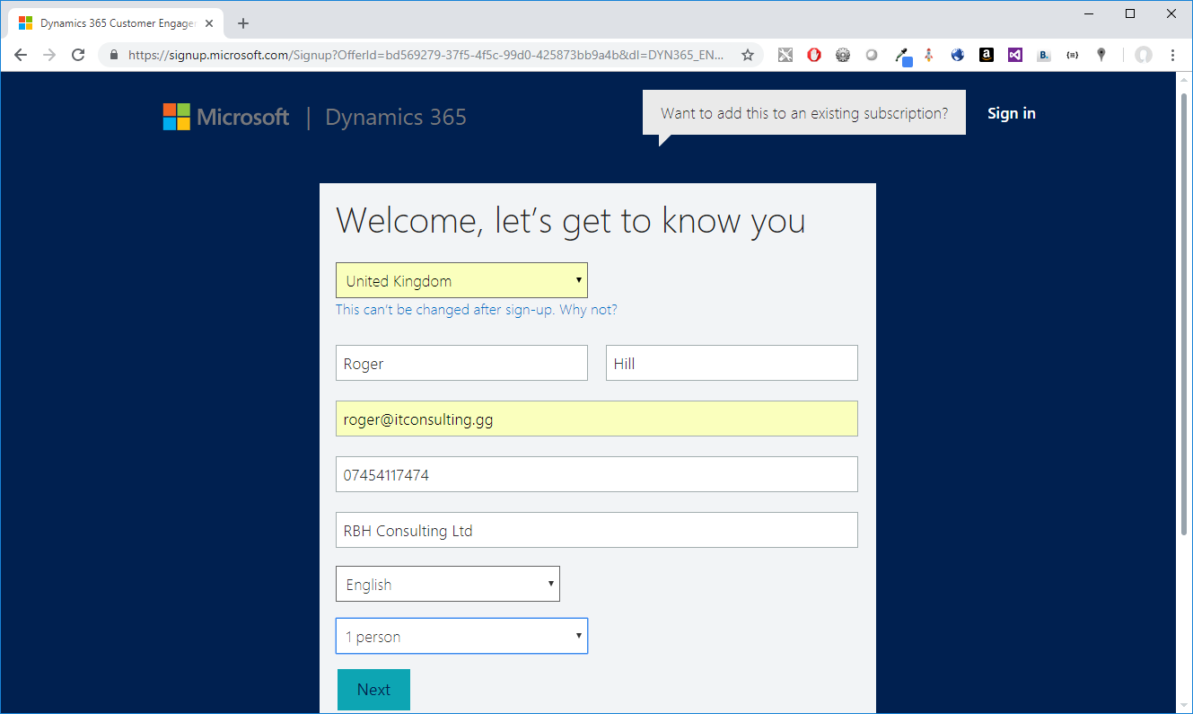
Setup online trial
Select UK, enter personal details

Slide 6
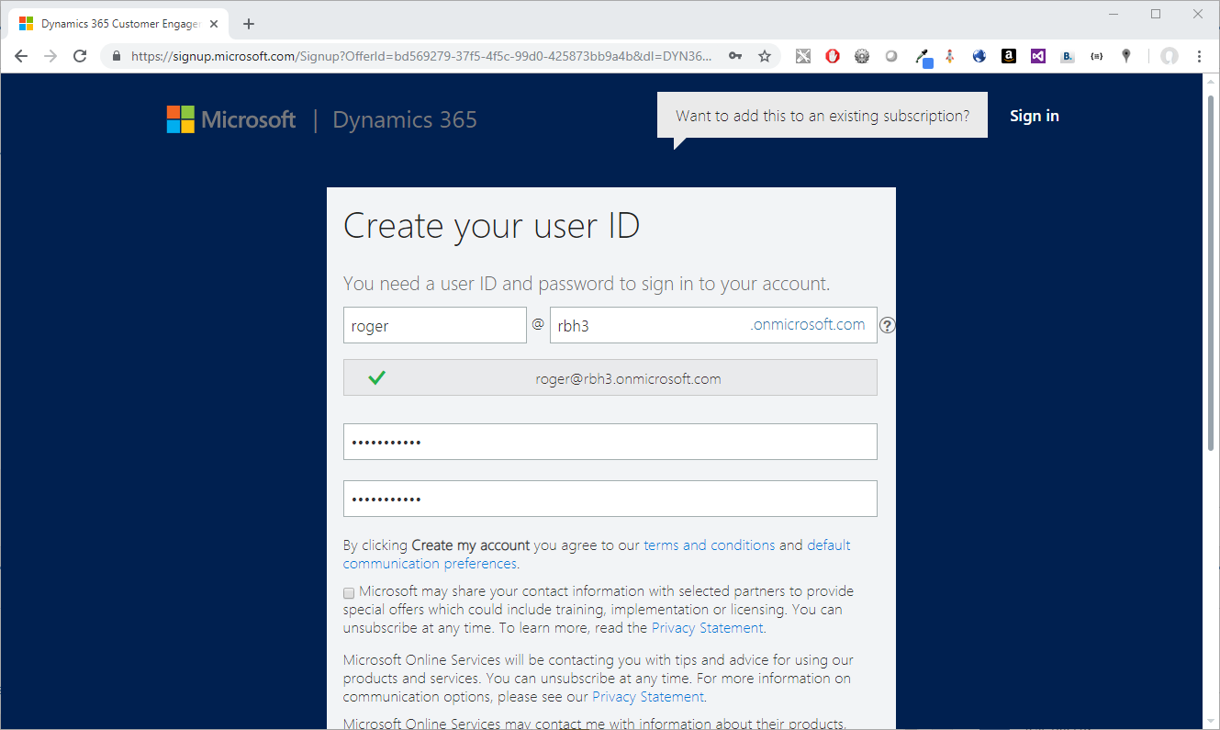
Setup online trial
Create a user ID
Chose a short user id and company name.
Notes:
When creating user ID (especially for training) use a short and easily remembered user name and company name. You will have to type it in a type it a lot.

Slide 7
Set up online trial
Enter phone number etc to verify identity

Slide 8
Themes
Give different systems a different colour

Slide 9
Custom Workflow Activities
Testing – make main logic a public function. Unit test.
Use FakeXrmEasy
Use Profiler

Slide 10
Plugins
Same as CodeActivities
Testing – make main logic a public function. Unit test.
Use FakeXrmEasy
Use Profiler

Slide 11
FakeXrmEasy
Install FakeXrmEasy.9 from nuget.
Create Test project

Slide 12
Deploying Workflows
Use Dynamics 365 Developer Toolkit Deployment project to deploy.
RegisterFile.crmregister
Ensures consistency

Slide 13
Workflow assembly versions
Be careful when changing the assembly version.
1.3.4.5
Major.minor.build.revision
Update workflow – public interface unchanged.
Only change build or revision.
Existing workflows will pick up the updated assembly.
Upgrade – significant differences.
Change major or minor version. Keep Name, Key Culture the same.
Existing Workflows keep the old version.
Should

Slide 14
Merging Assemblies
Problem – your plugin/custom activity depends on 3rd party assemblies.
How do you make these available to your plugin
Use ilmerge
Set “CopyLocal = false” on any Microsoft.Xrm etc assemblies.

Slide 15
Questions
Find me on linked in
Source code on this course available at https://github.com/rogerhillgsy/CRMTraining

